Slide 1
March Madness Bracket Predictor
Team 4: Andrew, Brandon, Christian, Rui

Slide 2
Requirements
1. Describe the problem and why a solution is potentially useful.
2. Describe the data – source, contents, cleaning, feature engineering, etc.
3. Present some interesting descriptive analyses (plots/tables).
4. Discuss the predictive methods you used. Why did you choose these, how did you
tune the parameters? Which model was most accurate? Why?
5. Tell us about obstacles. What was the biggest challenge you faced and how you
overcame it (or not, not every problem has a solution).
6. Conclude. What did you learn that can be put to practice?

Slide 3
Problem
Predicting outcomes in the NCAA March Madness tournament is extremely difficult due to high variability and frequent upsets
Traditional bracket selection relies heavily on intuition, bias, and limited statistics, leading to poor accuracy
Even strong teams aren’t completely safe due to factors like matchup dynamics, seeding discrepancies, and variance
This creates a clear opportunity for a data-driven approach that leverages historical team performance and advanced metrics
“Can machine learning outperform a baseline model in predicting tournament outcomes?”
Our objective: Build a machine learning model that predicts game outcomes to improve bracket accuracy beyond a chalk model

Slide 4
Data Structure
MRegularSeasonDetailedResults.csv
Full box score data for every regular season game since 2003
Source of team-quality features
Derived features
MNCAATourneyCompactResults.csv
Winners and losers
MNCAATourneySeeds.csv
Seed assigned to each team
MNCAATourneySlots.csv
Help build the bracket
Joined with MNCAATourneySeeds.csv to find matchups
MTeams.csv
Maps TeamID to team name
122775 regular season games, 2585 tourney games → 117447 regular season games, 1449 tourney games after cleaning

Slide 5
Data Structure
Base Data Construction:
Each row initially represents a team’s performance in a single game (winner and loser perspectives combined)
Split each row into each team’s perspective so every team has a record of their stat’s and their opponent’s stats (234,894 rows)
Feature Engineering: Created advanced team metrics including:
Shooting efficiency (FG%, TS%, eFG%)
Ratings (OffRtg, DefRtg, NetRtg)
Possession-based stats and turnover rates
Rolling performance (Last 5 / Last 10 games), Strength of schedule
Aggregation: Transformed game-level data into team-season features → Each row = one team in one season
Model Input Structure: For each matchup, we combine two teams’ features into one row → Model learns relative team strength to predict outcomes
Bracket Building:
Join Seeds and Slots on TeamID
Use ESPN bracket challenge scoring (x/1920)
Target Variable (y): Binary outcome at game level → 1 = team wins, 0 = team loses

Slide 6
Metrics/Features
feature_cols = [
'SeedDiff',
'DIFF_WinPct',
'DIFF_AvgMargin',
'DIFF_eFG_pct',
'DIFF_TS_pct',
'DIFF_OffRtg',
'DIFF_DefRtg',
'DIFF_NetRtg',
'DIFF_TO_rate',
'DIFF_Ast_TO',
'DIFF_ORR',
'DIFF_DRR',
'DIFF_FT_rate',
'DIFF_FG3A_rate',
'DIFF_Last10_WinPct',
'DIFF_Last10_Margin',
'DIFF_NeutralWinPct',
'T1_Off_vs_T2_Def',
'T2_Off_vs_T1_Def',
'NetMatchupEdge',
'DIFF_SoS'
]
21 total

Slide 7
MODELS
Notes:
Next take a look at models trained for our classifier
Total of 7 models
Accuracy is our most important metric when training
Since we have a classification problem we decided to use thresholds to improve accuracy
we created a threshold tuning function that chose the best threshold based on a validation split of the original training data
So, to begin…

Slide 8
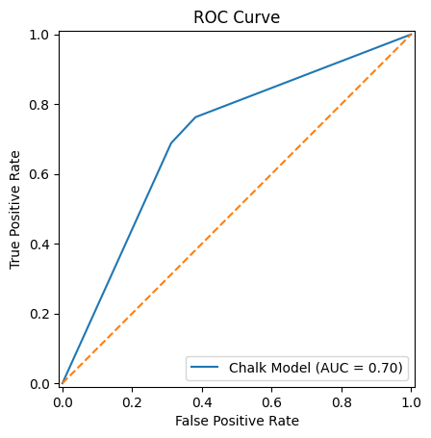
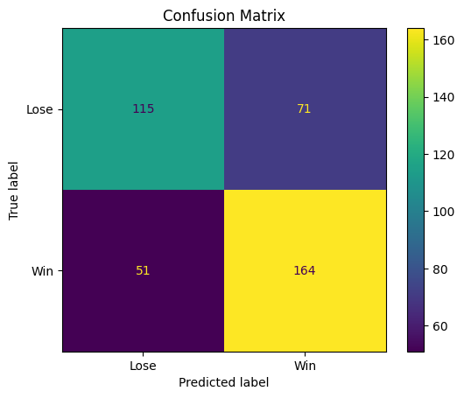
Chalk Model
Naive baseline
Always picks the lower seed
Accuracy: 69.6%
279/401 on test set
AUC: ~0.70
Key Insight:
Even this naive rule achieves surprisingly strong performance
Indicates that seeding already captures a large portion of predictive signal
Notes:
Chris
Our naive baseline
Chalk model always predicts the lower seed
The lower seed you are in a bracket, the “stronger” your team is
Predicted at about 70% accuracy
The naive rule is surprisingly stronger than a 50/50 split rule
Shows seeds already capture a large amount of data when it comes to whether a team will win or not

Slide 9
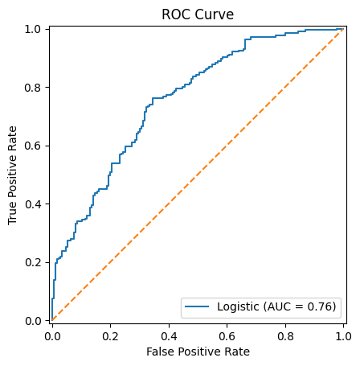

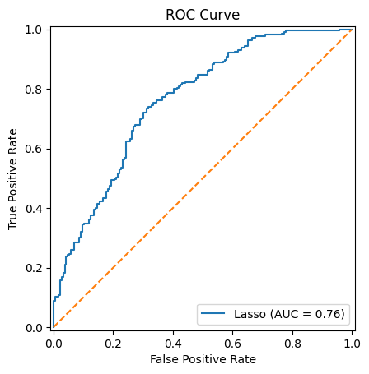
Linear Models w/ 5-Fold Cross-Validation
Unregularized Logistic Regression
Accuracy: 71.1%
AUC: .756
Log loss: .584
Ridge Regression w/ CV
Accuracy: 68.6%
AUC: .761
Log loss: .571
Lasso Regression w/ CV
Accuracy: 70.0%
AUC: .762
Log loss: .580
Notes:
Chris
Next trained three linear models: Base Logistic Regression, Ridge Regression, and Lasso Regression
All scalled using standard scaler before training
Unregularized logistic regression performed the greatest at 71% but still only 2% above our baseline chalk model

Slide 10
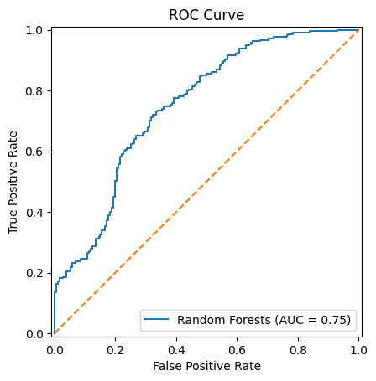
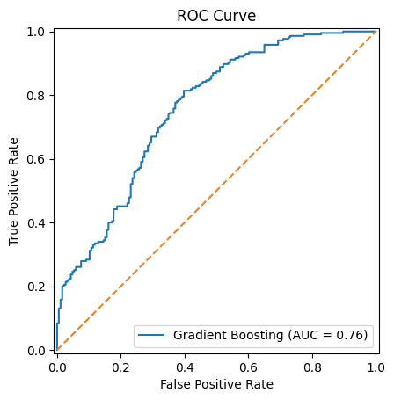
Tree Models w/ Grid Search
Gradient Boosting
Accuracy: 69.1%
AUC: .574
Log loss: .755
Best params: estimators: 100, learning rate: .05, max depth: 2
Random Forest
Accuracy: 68.8%
AUC: .584
Log loss: .751
Best params: estimators: 300, max depth: 4, min samples leaf: 2
Both models picked conservative configurations
Notes:
Chris
Moving on to our tree models
Trained a gradient boosting model that performed at about 69% accuracy and a random forest model that performed at around the same accuracy
Both lower than our baseline models
The parameters of these models were tuned using grid search

Slide 11
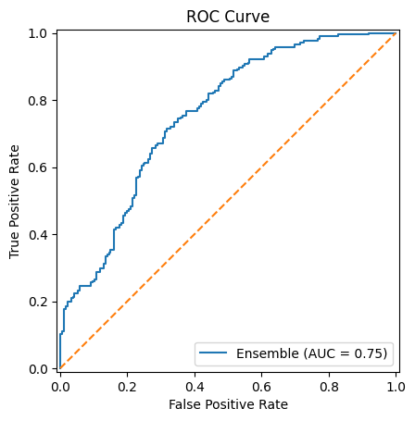

Ensemble (GB + RF)
Soft voting system that averaged the predicted win probabilities from GB and RF
Preserves confidence information
Prevents ties
Accuracy: 69.8%
AUC: .579
Log loss: .754
Notes:
Chris
Lastly our ensemble model, which used a soft voting system with Gradient Boosting and Random Forests
Soft voting allows us to keep how confident we are in a prediction, as well as preventing ties between our two estimators
Unfortunatley the model only outperforms our baseline by about half a percent

Slide 12
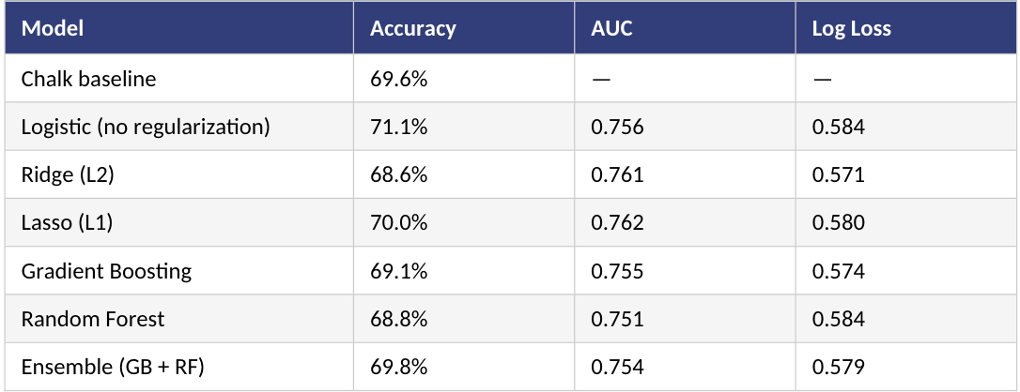
Model Comparison & Final Selection
Key Takeaways
Logistic Regression achieved the highest accuracy (71.1%), outperforming all other models
More complex models (GB, RF, Ensemble) did not significantly improve performance
Regularization (Ridge/Lasso) slightly improved stability but reduced accuracy
Overall performance gains over the baseline (69.6%) are modest
80/20 train/test split
Only trained on regular season stats from pre-tourney
Notes:
Chris
In the end the most accurate model we trained was a logistic regression model w/ no regularization
Logistic regression is a relatively simple model, suggesting that the relationships in our data are largely linear with respect to the engineered features.
The more complex models may be overfitting

Slide 13
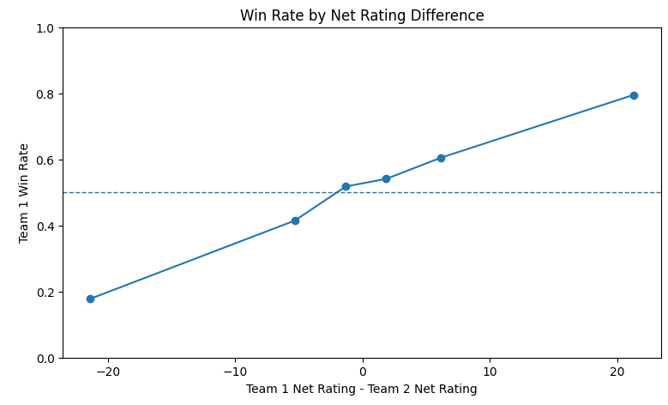
Key Insight: Net Rating Difference is a Strong Predictor
This chart illustrates the relationship between net rating difference and win probability.
X-axis: Net Rating Difference = Team 1 Net Rating – Team 2 Net Rating
Positive → Team 1 is stronger
Negative → Team 1 is weaker
Y-axis: Probability that Team 1 wins
The dashed line at 0.5 represents a baseline (even matchup)
Key Insights
Win probability increases as the difference in net rating grows, showing that stronger teams are more likely to win
The relationship is steady and consistent, suggesting net rating is a reliable measure of team strength rather than random variation
When the difference is close to zero, outcomes are much less predictable, which explains why evenly matched games often result in upsets
As the gap between teams becomes larger, outcomes become more predictable, allowing the model to make more confident predictions
Notes:
One key insight from our analysis is that net rating difference is a strong predictor of game outcomes.
On this chart, the x-axis shows the difference in net rating between two teams, and the y-axis shows the probability that Team 1 wins.
As we can see, there is a clear upward trend — as the net rating gap increases, the probability of winning also increases.
This suggests that net rating is a reliable measure of team strength.
However, when the difference is close to zero, outcomes become much less predictable, which helps explain why evenly matched games often result in upsets.

Slide 14
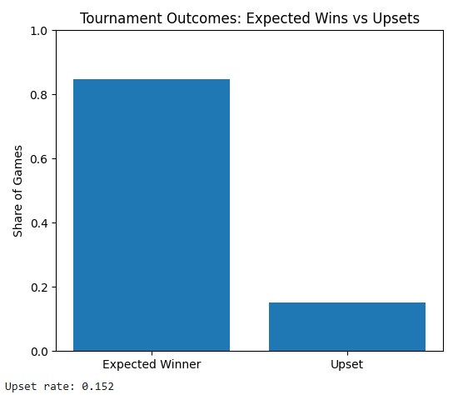
Upsets Introduce Uncertainty
“Expected Winner” = better team (by seed) wins
“Upset” = worse team wins
Most games follow expected outcomes based on team strength
A meaningful share of games still result in upsets
These unpredictable outcomes limit the accuracy of simple rules
Highlights the need for a model that can handle uncertainty

Slide 15
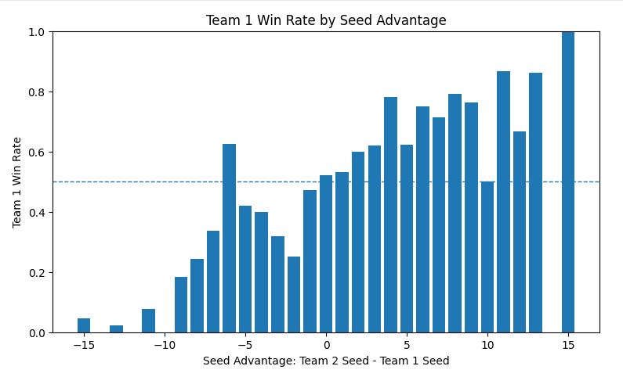
Key Insights: Seed Advantage and Win Probability
This chart illustrates the relationship between seed advantage and win probability.
X-axis: Seed Advantage (Team 2 Seed – Team 1 Seed)
Positive values mean Team 1 has the better seed
Negative values mean Team 1 is the underdog
Y-axis: Probability that Team 1 wins
The dashed line at 0.5 represents a baseline where the game is essentially a coin flip
Key Insights
There is a clear positive relationship between seed advantage and win probability
Teams with better seeds are more likely to win
When seed advantage is close to zero, win probability is near 50 percent.
There is noticeable variability across values.
Even with a seed advantage, outcomes are not guaranteed
Extreme seed differences lead to very high or very low win probabilities
Strong favorites usually win, but not always

Slide 16
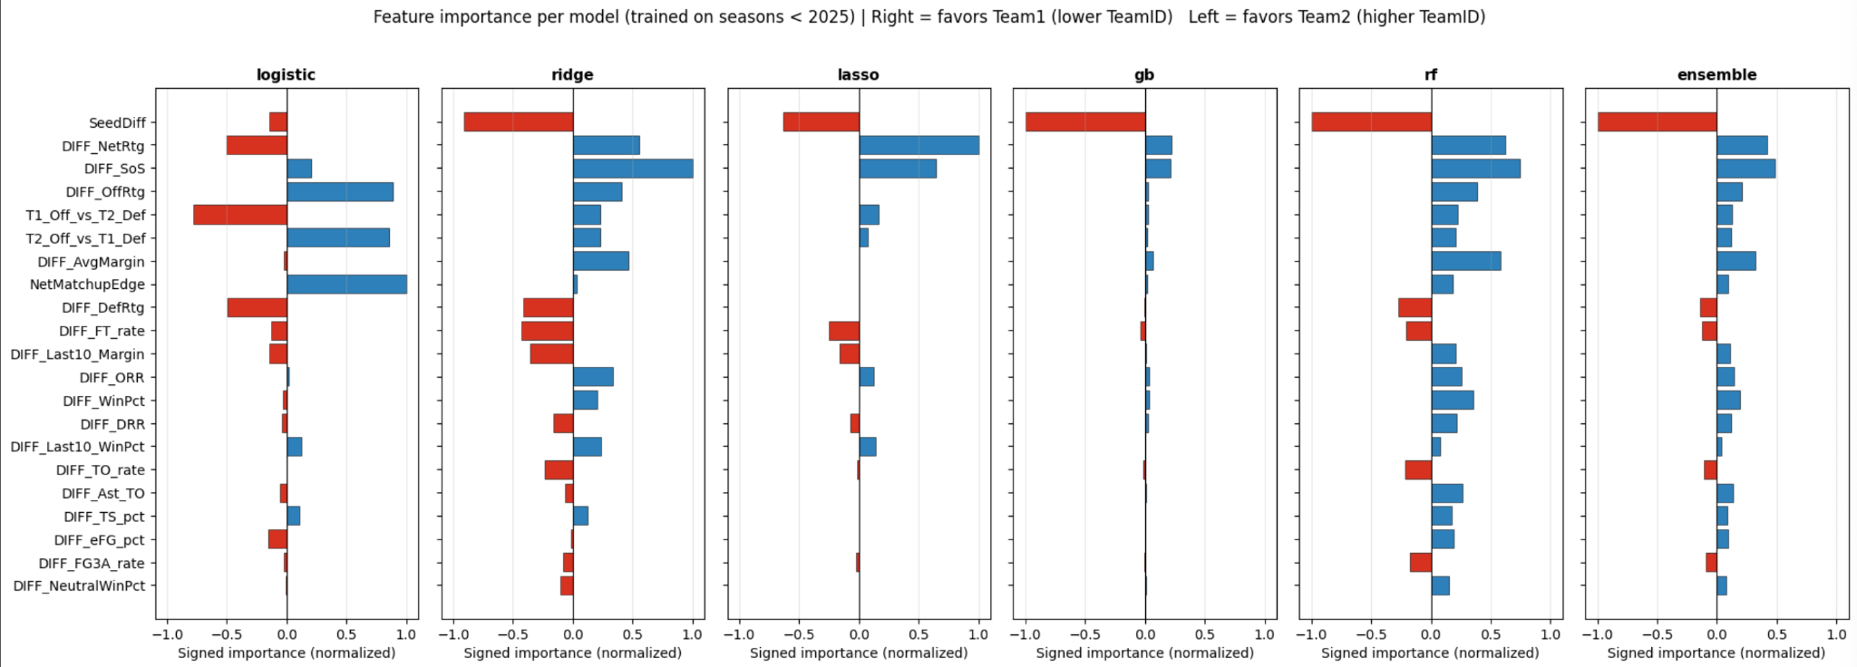
Key Insights
SeedDiff dominates in most models
SoS showed up in most models
GB barely uses other features - like a chalk model

Slide 17
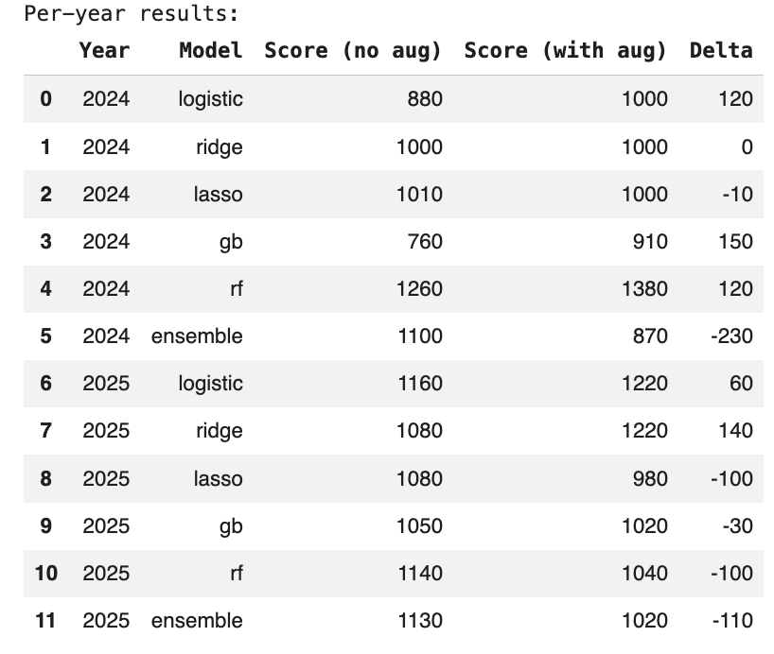
Experiment
In response to GB being a glorified chalk model…
Collapses into SeedDiff, ignored other features
Tourney data and regular season averages not large enough
Seeding encompasses a lot of features
To fix this…
Ran an alternate pipeline without SeedDiff
3/6 models performed better, including GB
Results iffy overall; need larger sample size

Slide 18
Obstacles
Obstacle: Limited Access to Current Season Data
Current season statistics were unavailable at the time of analysis
Most publicly available datasets only included historical seasons
This limited our ability to:
Evaluate model performance on the most recent tournament
Capture real-time team form and late-season changes
As a result, the model was trained and tested primarily on past seasons
Our Solution:
Focused on building a model using historical trends and patterns
Designed features (net rating, recent performance) to approximate team strength
Evaluated performance using out-of-sample historical data

Slide 19
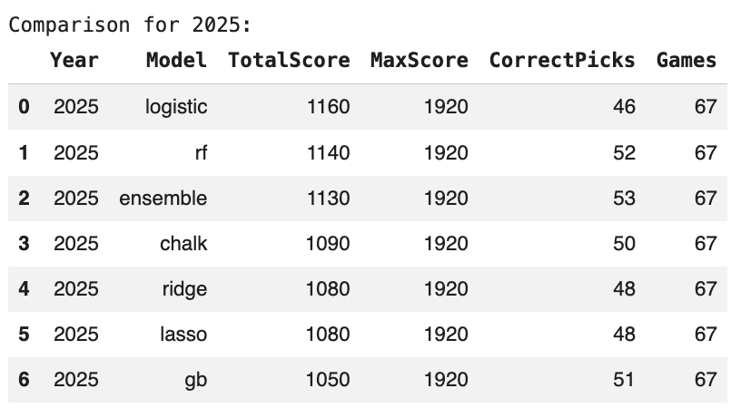
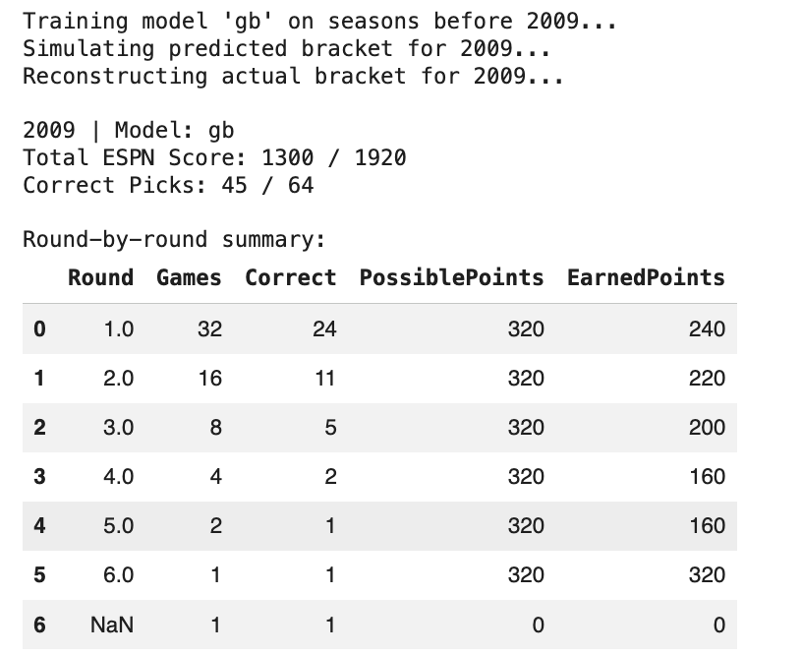
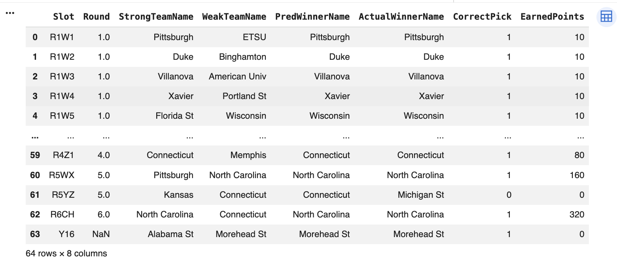
Highlights
Best performance
Notes:
Next, here are some highlights from our model performance.
On the left, we show an example of a simulated bracket from 2009. The model achieved about 70% accuracy overall, which is consistent with our earlier results.
However, even with relatively high accuracy, the total score is still far from the maximum, because mistakes in later rounds are much more costly.
When comparing different models on the 2025 bracket, logistic regression achieved the highest total score, while ensemble and random forest also performed competitively.
Overall, most models performed within a relatively narrow range, which again suggests that the problem is inherently difficult.
Even the best-performing models only improve moderately over the chalk baseline, reinforcing that much of the signal is already captured by simple features like seeding.

Slide 20
Conclusion
Use regular season data earlier in the process
Use better metrics such as KenPom, BPI,
Monte Carlo simulation
Notes:
conclude, there are several ways we could further improve the model.
First, incorporating regular season data earlier in the pipeline could help capture team strength more accurately before the tournament begins.
Second, using more advanced metrics such as KenPom or BPI could provide better representations of team quality.
Finally, instead of making single deterministic predictions, we could use Monte Carlo simulations to model uncertainty and generate more robust bracket outcomes.
Overall, our results show that while machine learning can improve predictions, the gains are limited by data quality and the inherent randomness of the tournament.

